Slide 1
Lesson 5 Abstract and Introduction
任课教师：刘昱朗
Email: yulangliu@hotmail.com

Slide 2
Outline
Title
Abstract
Introduction

Slide 3
Title
It requires Topic Keywords
It requires the description of your work

Slide 4
Abstract
What is an abstract?
One of the most important parts of a scientific article is the abstract. Successful authors put substantial effort into crafting their abstracts, which act like advertisements for their papers.

Slide 5
Abstract
Why is the abstract so important?
Well, because it is often the only section of a paper that is read and usually determines whether a reader downloads and reads the rest of the paper. Or, in the case of a conference paper, the abstract will determine whether it is accepted or not for presentation to colleagues. Conference organizers and journal editors and reviewers pay close attention to the abstract because it is a good predictor of the quality of the paper or talk. A poorly written abstract says the author is inexperienced or doesn’t care about quality.

Slide 6
Abstract
What problem did you study and why is it important?
What methods did you use to study the problem?
What were your key findings? The advantages of your methods?
What did you conclude based on your methods

Slide 7
Abstract
How to write abstract?
1) Introduction (2 sentences):
Sentence 1: Basic introduction to the field; accessible to scientists of any discipline.
Sentence 2: Background of the specific research question; comprehensible to scientists in the same or closely related fields of research.

Slide 8
Abstract
How to write abstract?
2) Problem/objective (1 sentence):
Explanation what is missing/unknown/problematic, i.e. why the current study happened. Typically, this sentence starts with “However”.

Slide 9
Abstract
How to write abstract?
3) “Here we show” (1 sentence):
The main result/key finding summarized in one sentence

Slide 10
Abstract
How to write abstract?
4) Main results and conclusions (~ 3 – 5 sentences)
Summary of the most important findings of the study that are the foundation of the main conclusions.
Unless the method is new and/or a main part of the paper, there’s no need to include any details in the abstract.

Slide 11
Introduction
Why is the introduction so important?
This is where you describe briefly and clearly why you are writing the paper. The introduction supplies sufficient background information for the reader to understand and evaluate the work you did.

Slide 12
Introduction
How to write introduction
Start with the problem you investigate.
Provide relevant background, but don’t begin your true argument.
Provide only helpful, relevant references.
The disadvantages of the previous work.
Introduce the method you propose and the work you have done, and convince the reader your work is of significant meaning

Slide 13
Assignments
Search a paper on Journal of Journal of Electronic Science and Technology (JESCT)
Download it via CNKI
Translate the title, abstract and introduction of the paper
Format
Name of the profile: Name-Class-StudentNumber

Slide 14
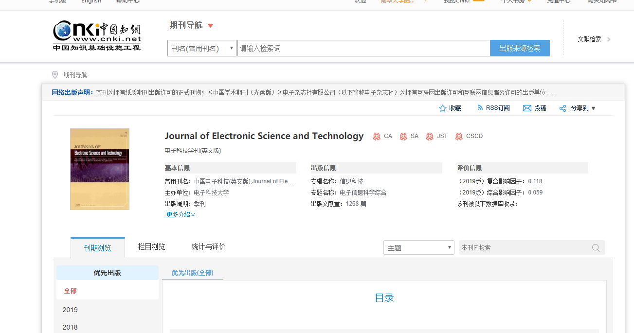
JESTC
http://navi.cnki.net/KNavi/JournalDetail?pcode=CJFD&pykm=ZGKE

Slide 15
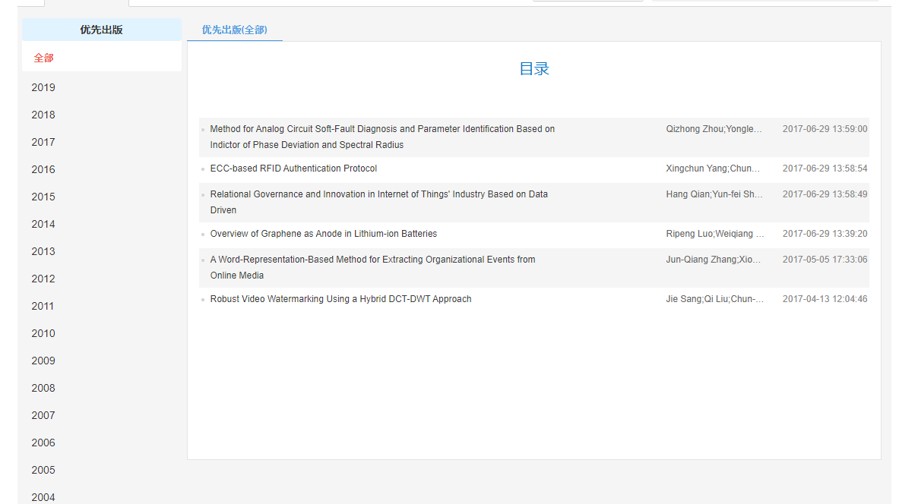
JESTC

